Slide 3
Helping Other People Everyday
99% of donations stay in Schuylkill County
30 member, volunteer Board of Directors
All campaign prizes are donated

Slide 4
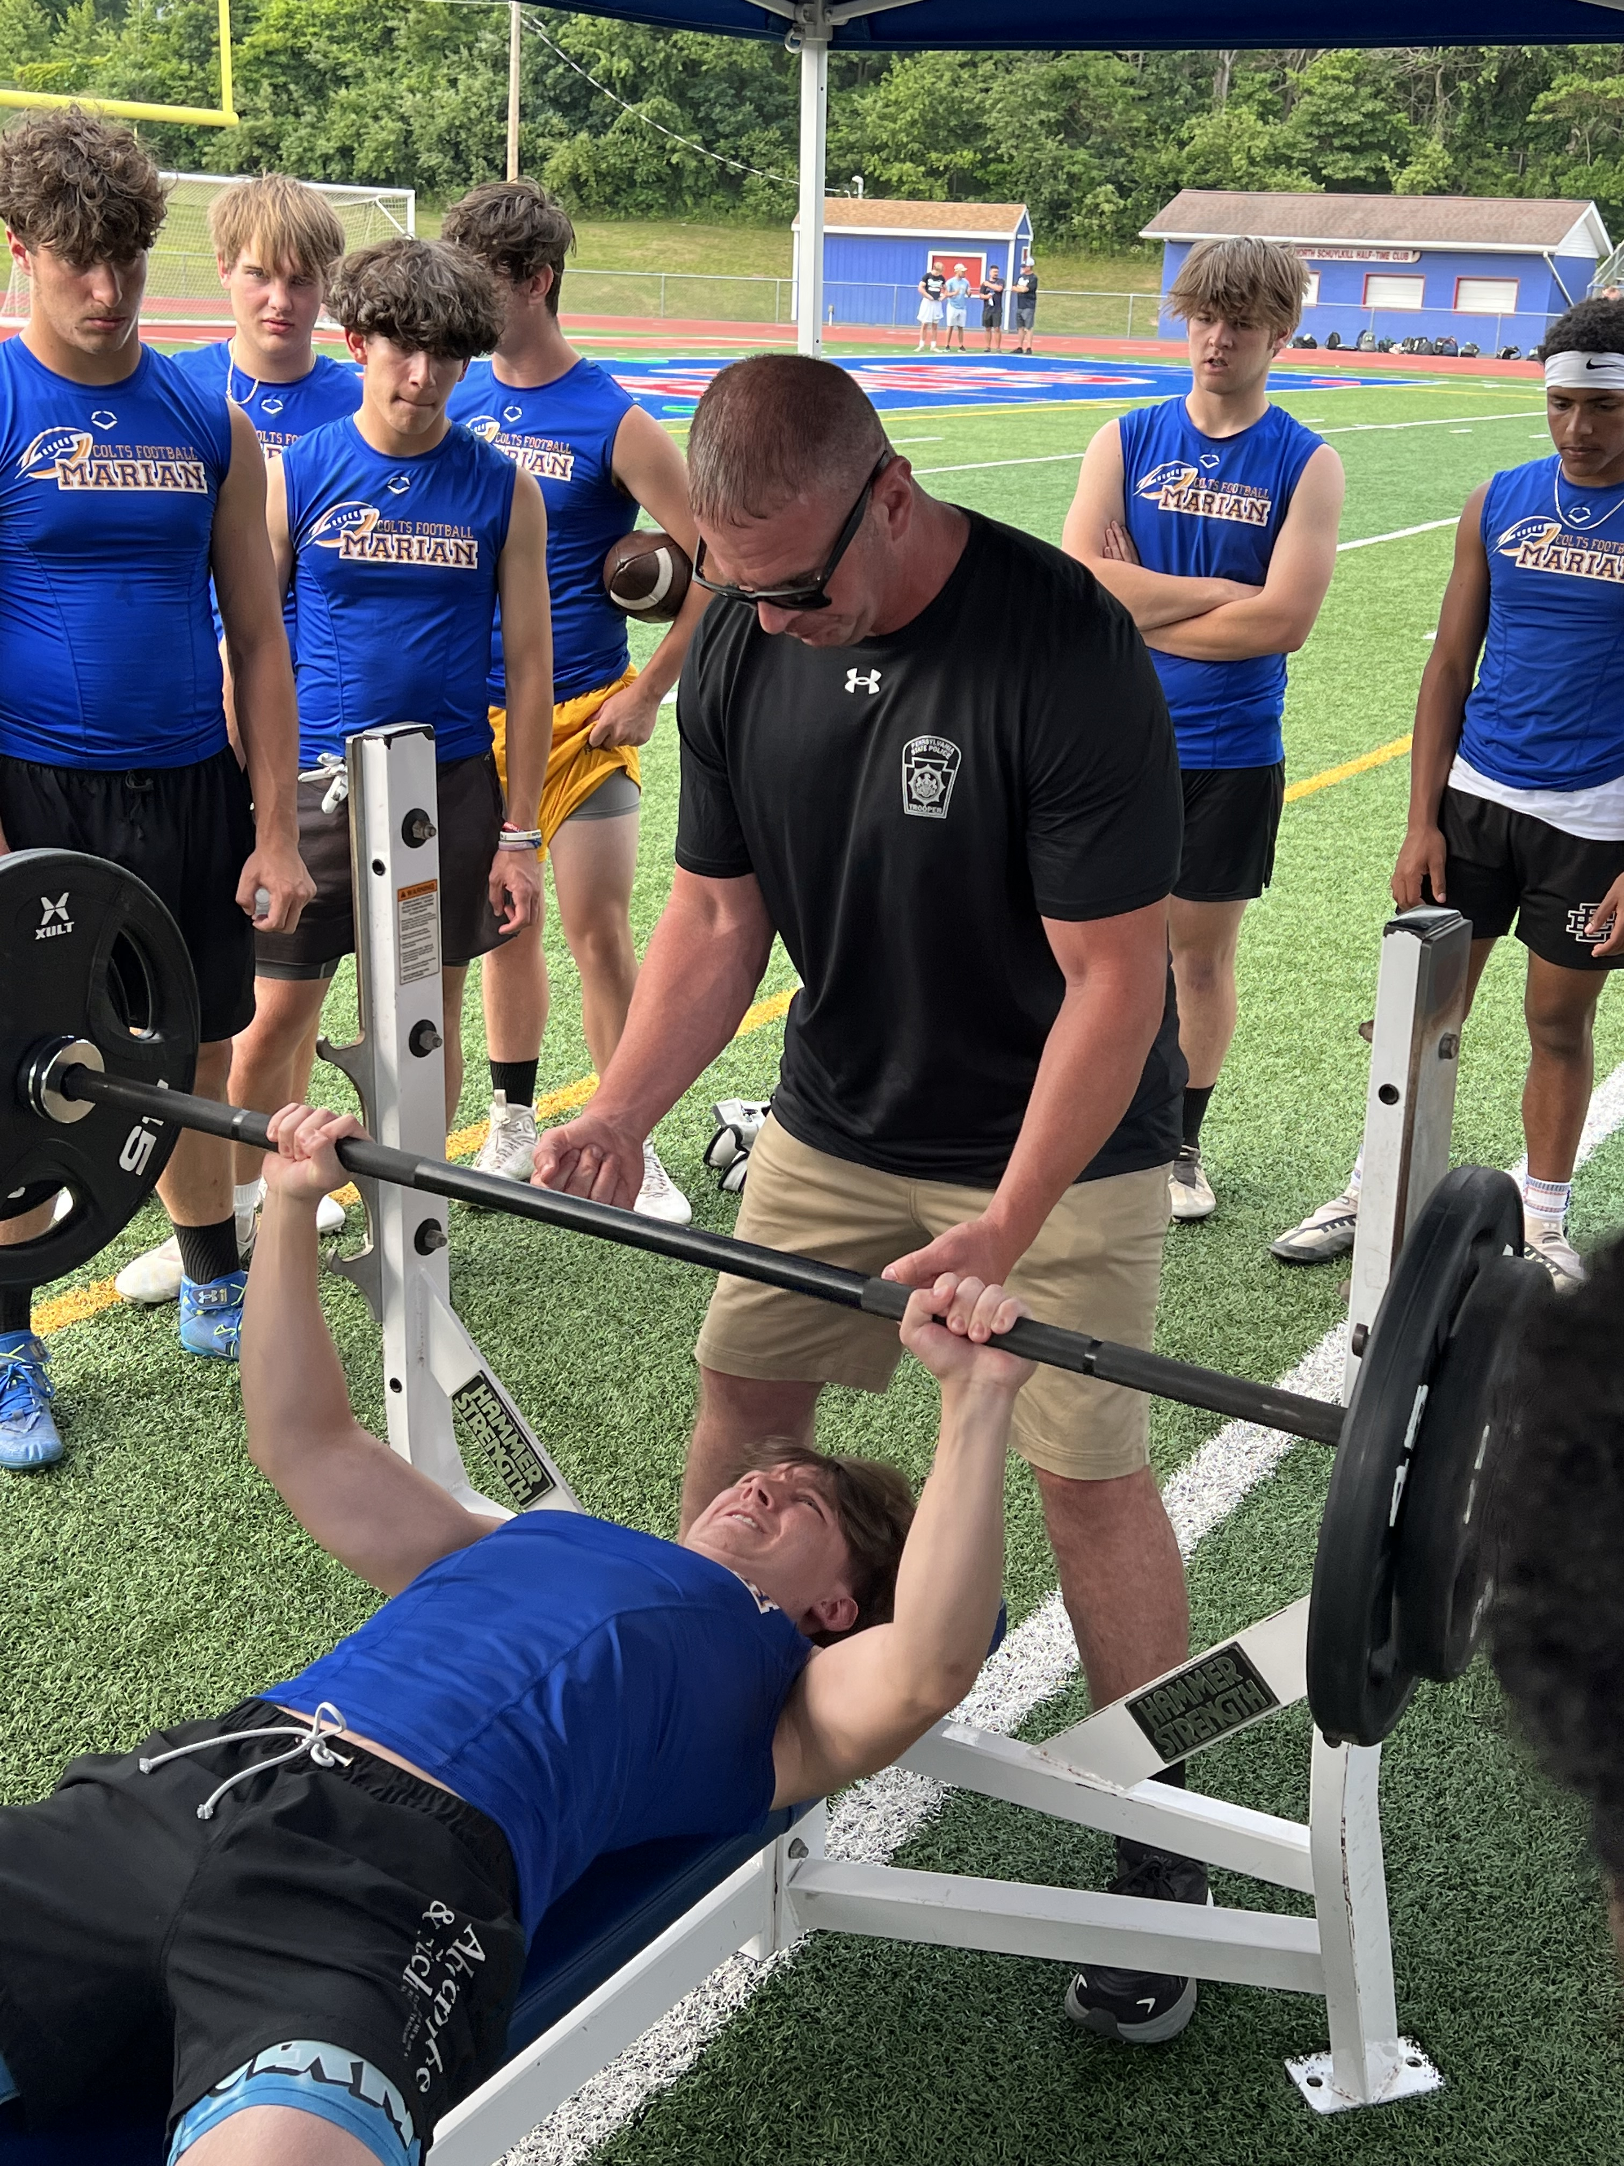
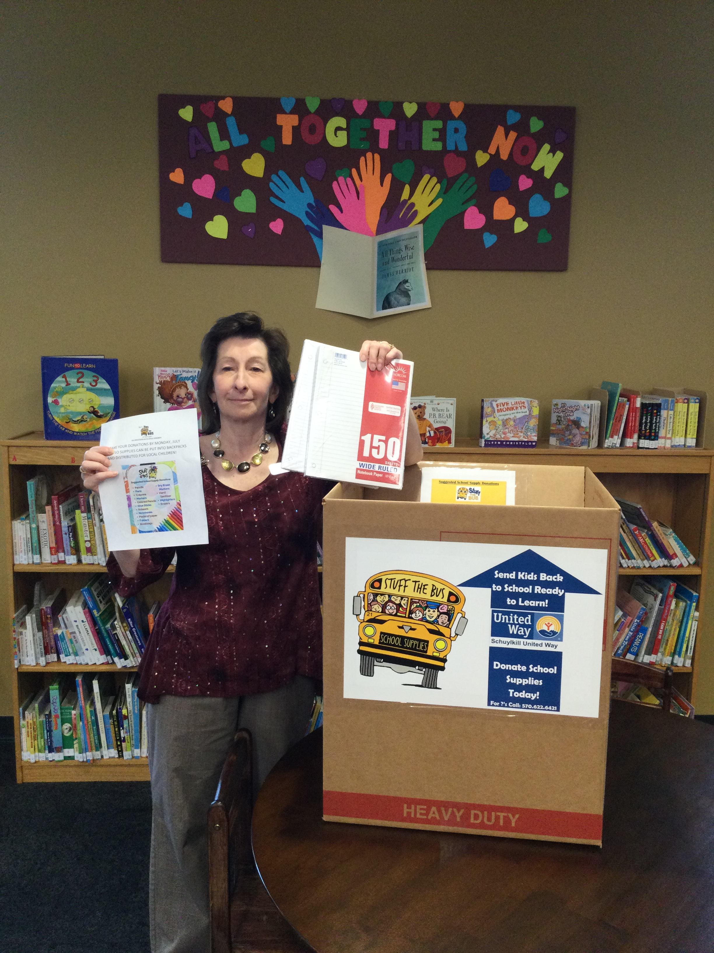
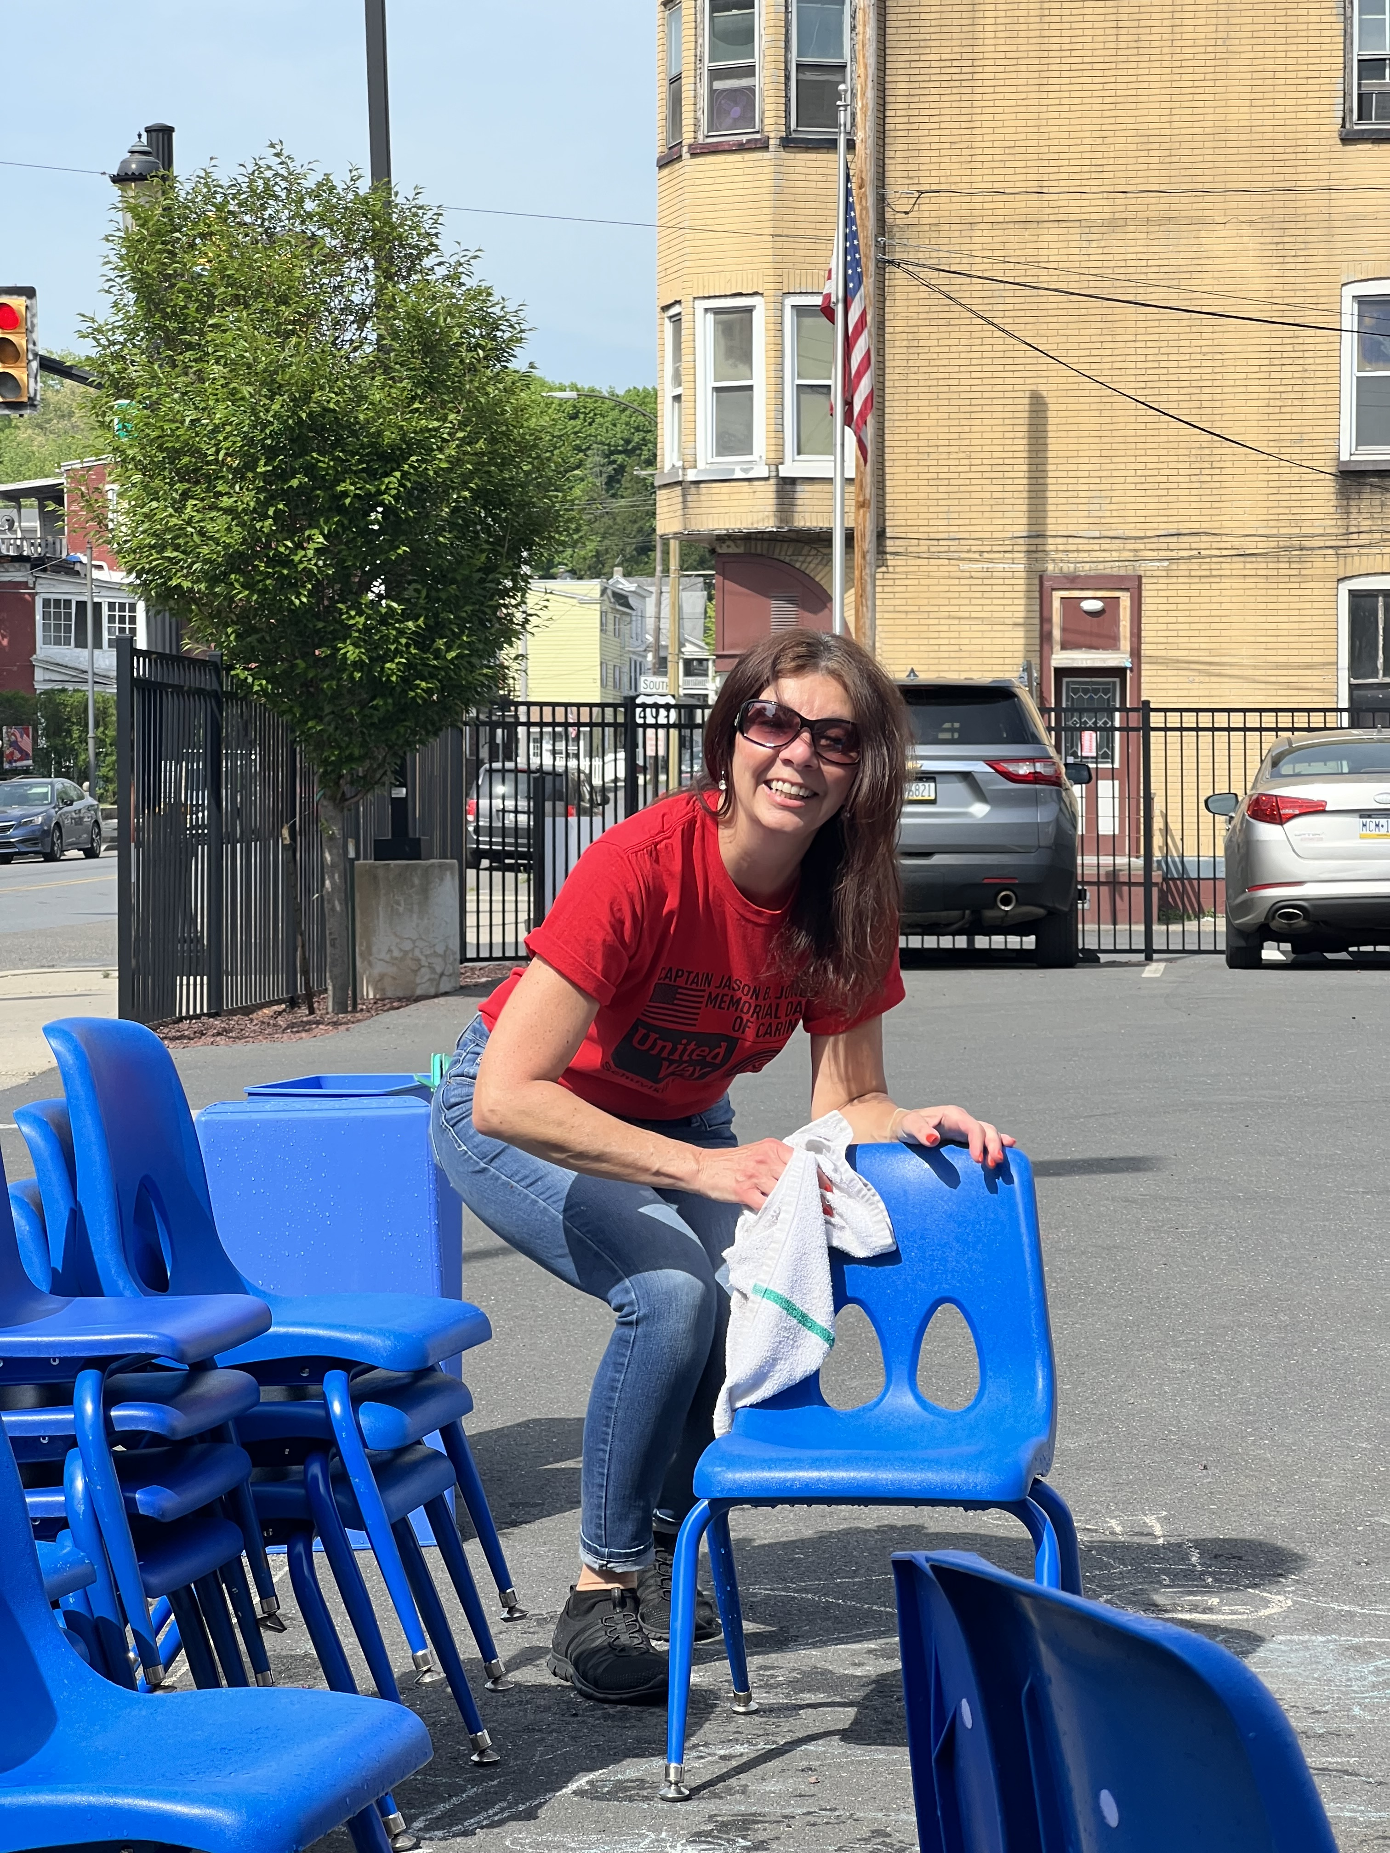
Helping Other People Everyday
Captain Jason B. Jones Memorial Day of Caring
High School Football Challenge
Stuff the Bus

